Slide 1
Probability

Slide 2
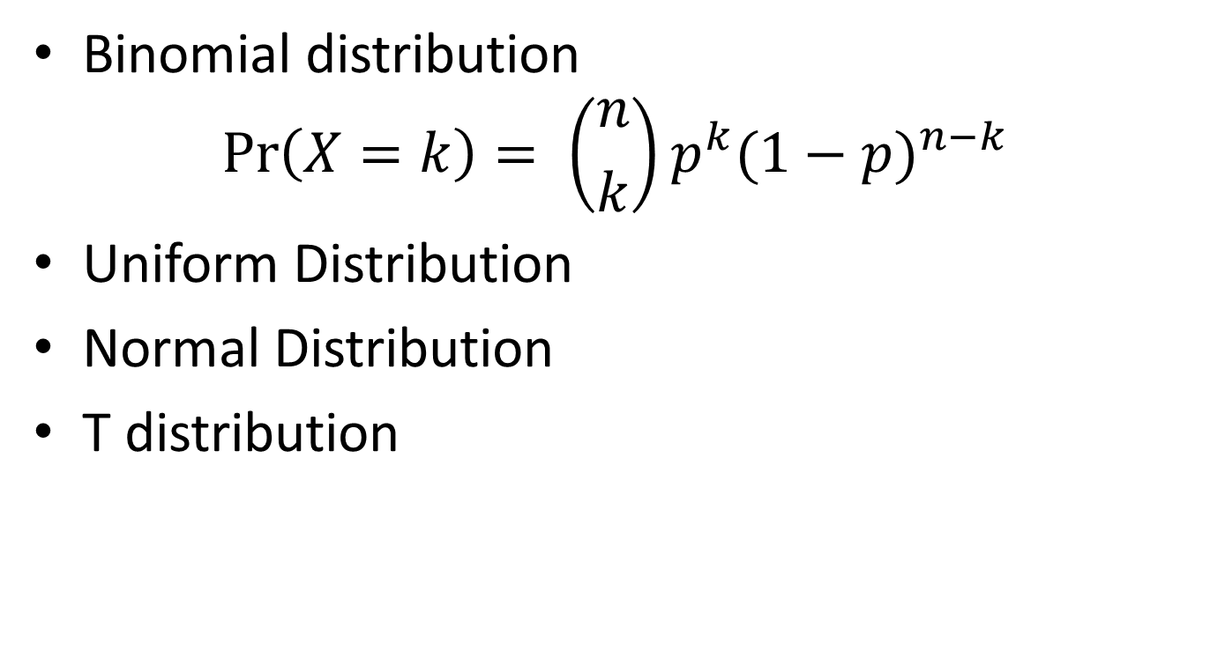
Probability Distribution
Binomial distribution
$$\operatorname{Pr}\left(X=k\right)= \left({n \atop k}\right)p^{k}{(1−p)}^{n−k}$$
Uniform Distribution
Normal Distribution
T distribution

Slide 3
R - code
dbinom(0, size=3, prob=1/2)
x = seq(0, 3, by=1)
prob_x = dbinom(x, size=3, prob=1/2)
cbind(x, prob_x)
plot(x, prob_x, type='h', col='red', main='Binomial(3,1/2)')

Slide 4
R-code
y = seq(0,50,by=1)
prob_y = dbinom(y,50,0.20)
plot(y, prob_y, type='h', col='red', main='Binomial(50, .2)')

Slide 5
R-code
x = seq(-1,2, length=100)
unif01 = dunif(x, min=0, max=1)
plot(x, unif01, type='l', col='red', main='Uniform[0,1]')
x = seq(-3, 3, length=100)
normal01 = dnorm(x, mean=0, sd=1)
plot(x, normal01, type='l', col='red', main='Normal(0,1)')

Slide 6
R-code
rbinom(1, 10, prob=0.5)
binom_sample = rbinom(1000, 10, prob=0.5)
table(binom_sample)
freq = table(binom_sample)
barplot(freq, xlab = 'X=number of heads')

